Slide 1
Aristotle & Aquinas
and Describing Living Things

Slide 2
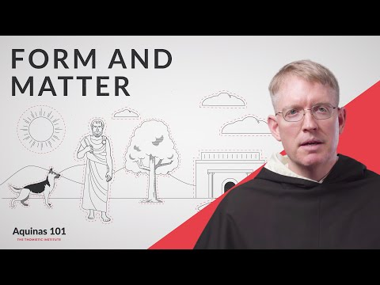
Form and Matter

Slide 3
Form: Definition
“It is that in a being which makes it to be this kind of being and not some other”
actuality → actual existence as a particular thing
makes a thing intelligible
the “ness” of a thing → “tableness” “cookieness”
Notes:
Form Definition! “It is that in a being which makes it to be this kind of being and not some other”
Form says that in order to have matter of any kind there has to be a prior principle of form by which the matter is constituted or comes about
Ex: There is something unique about a cat that makes it a cat
Ex: there has to be something explicitly table-like to make a table
Ex: the soul is a form of living things; the soul is the form of the body
The soul is deeper than mere consciousness, it is the very organizing principle of one’s identity

Slide 4
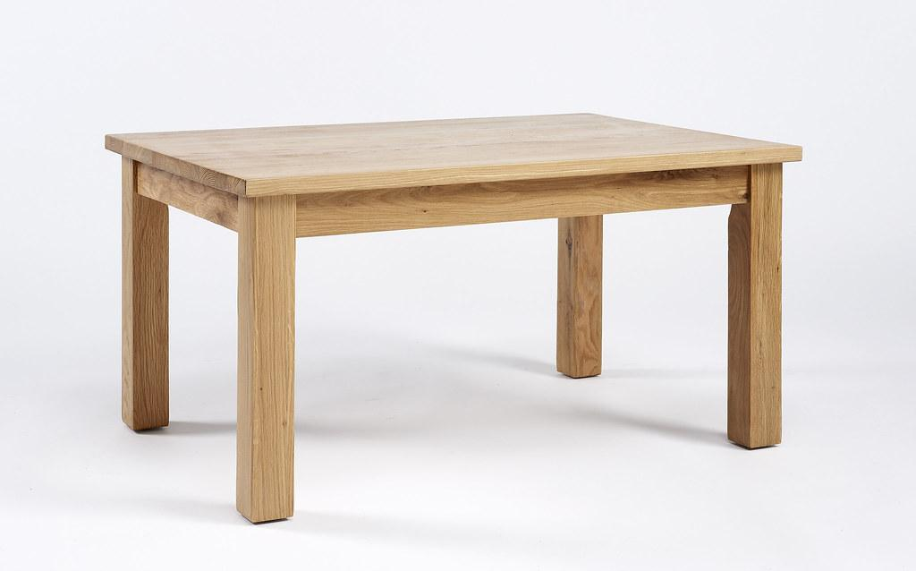
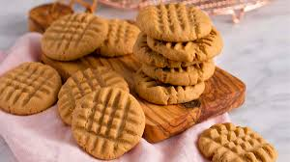
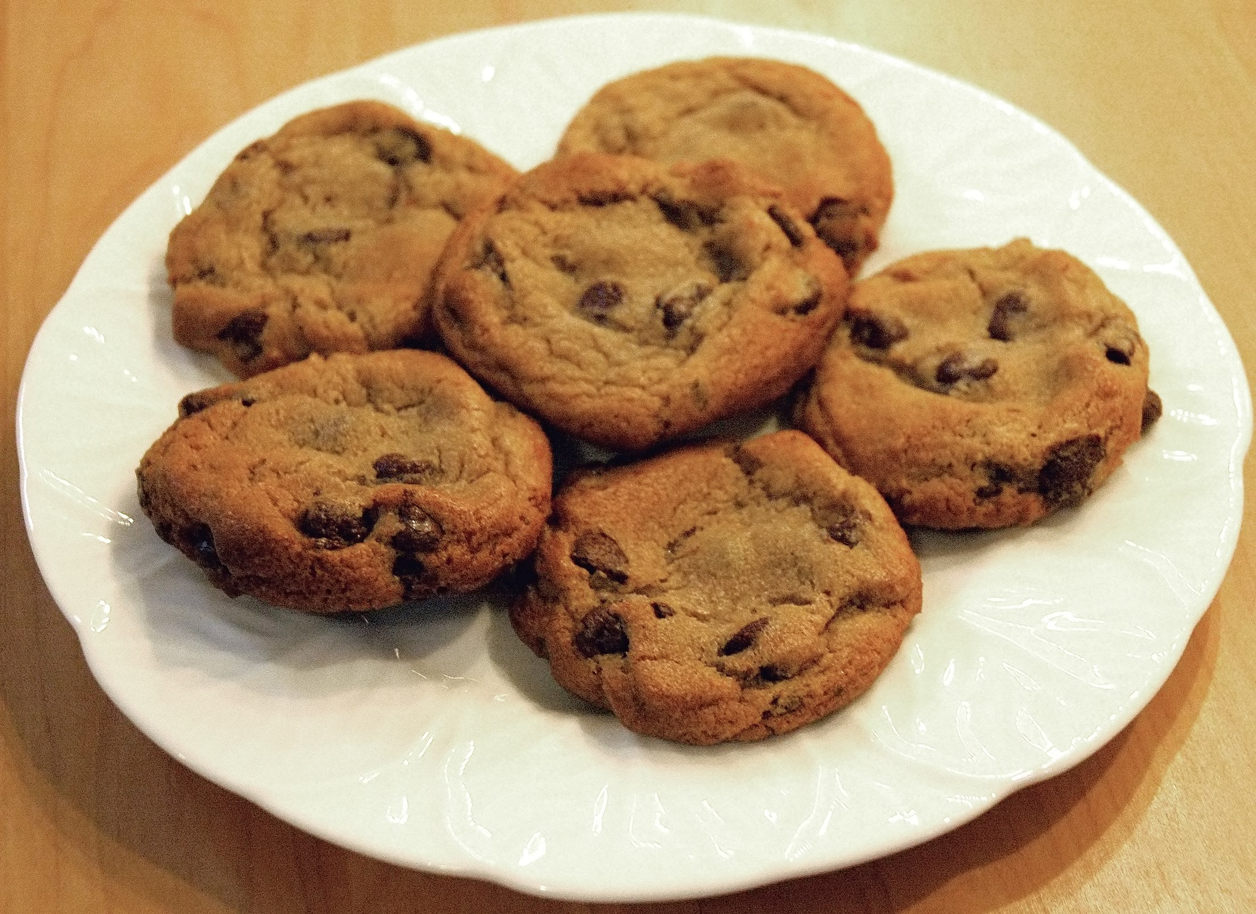
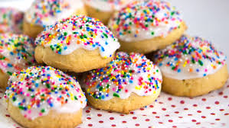
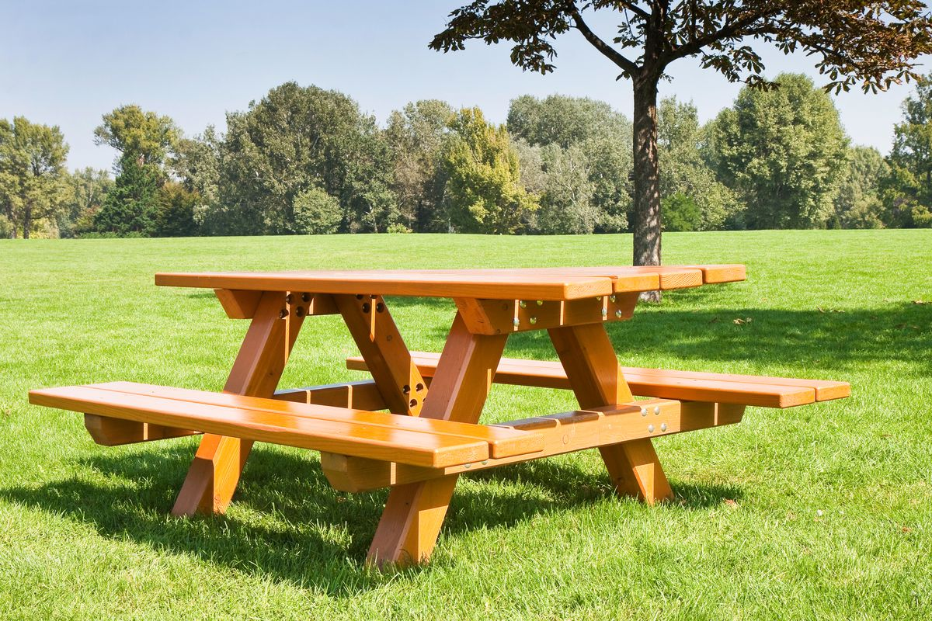
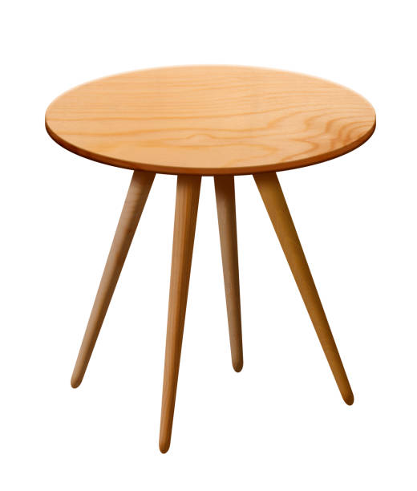
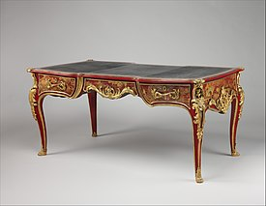
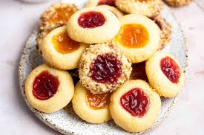
Notes:
A carpenter holds and follows a form
When baking cookies you hold a form when you scoop them out vs a cake

Slide 5
Matter: Definition
the basic “stuff” of individually existing things
potency → has potential to become
distinguishes
two things may look the same, feel the same, indeed be qualitatively and quantitatively the same
still be different because they have their own matter
Notes:
Matter = how we distinguish at the level of essence
Does not exist on it’s own- must be united with a form
Form makes it what it is
The “stuff”
Potency
F+M: Both exist together but as we try to study being as it is, we must consider!

Slide 6
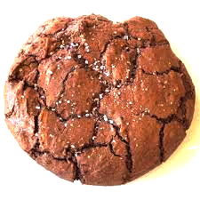
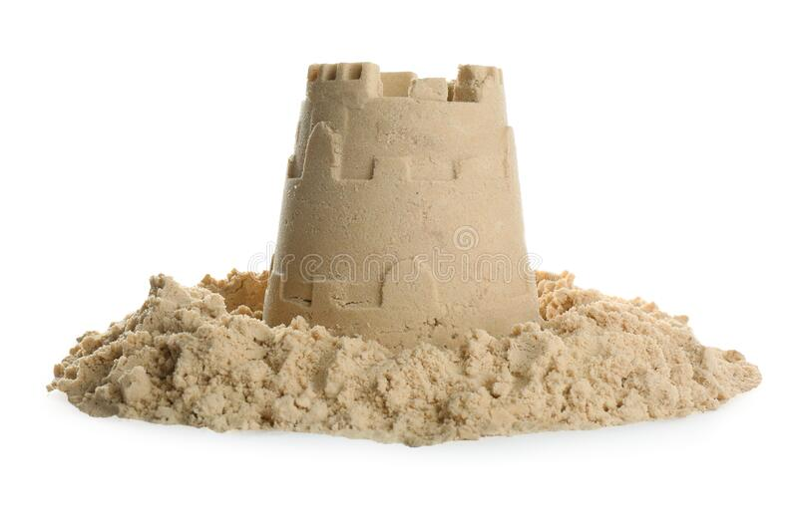
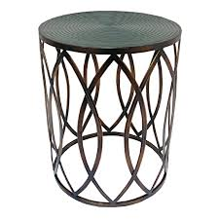
Hylomorphic Union: Form and Matter
every physical object is a compound
matter and form
Can you have form without matter?
Can you have matter without form?
Notes:
Hylomorphic principle: every physical object is a compound of matter and form→ from aristotle

Slide 7
The 4 causes
Handout: The Four Causes, Aristotle, Physics excerpt
formal cause → form (shape/order/structure/organization)
material cause → matter (stuff)
efficient cause → thing that acts (agent)
final cause → reason for existence (idea/design/purpose/end)
Which two are properties of an object itself?
Which two are external to the object but lead to the object's existence?

Slide 8
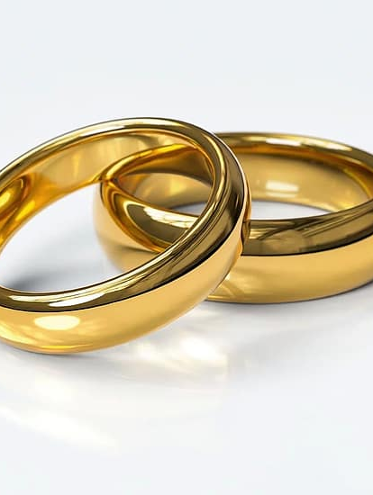
Form
circular → “ring”
finger sized
Matter
Gold
When the jeweler imposes the circular “form” to the golden “matter” it becomes a wedding ring
Notes:
Form: It’s what we know to be a ring
Until the matter is united to the form it’s just gold

Slide 9
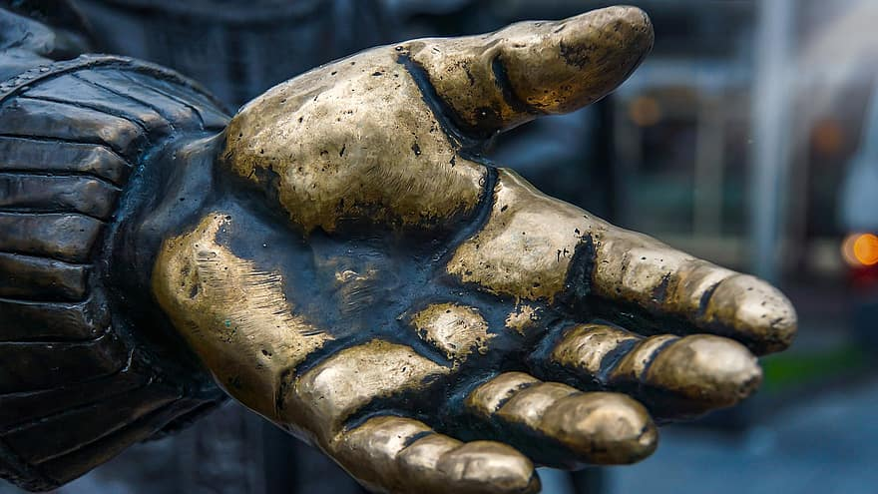
Form
The shape: hand
Matter
Bronze
When an artists imposes the human “form” to the bronze “matter” it becomes a sculpture
Notes:
Matter is that which limits a being to being an individual thing, a 'one of' its particular type. The form determines what type of thing a thing is.

Slide 10

A Novel
Form
The story itself
Matter
Cover, spine, pages, ink...
Efficient cause
The author who writes the story
Final cause
Purpose for which the author writes (changes from author to author)

Slide 11
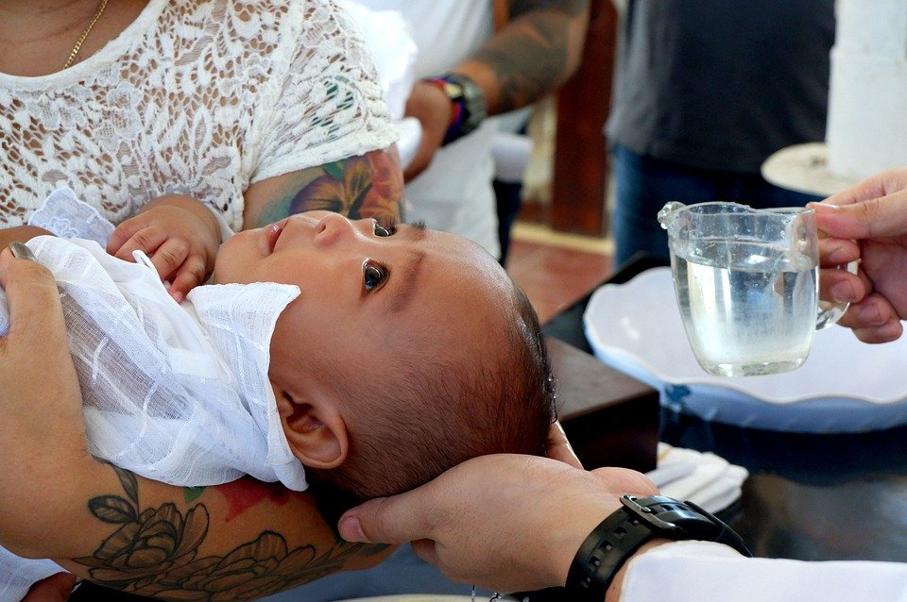
Form
“I baptize you in the name of the Father, and of the Son, and of the Holy Spirit”
Matter
Water
When a priest imposes the matter of water with the form of the sacrament, we recognize someone is not receiving a bath, but becoming a Christian

Slide 12
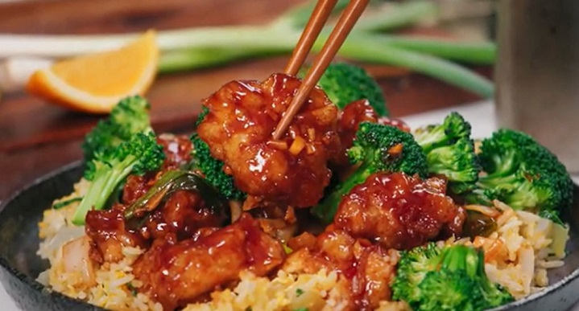
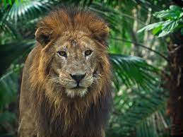
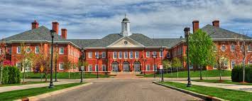
Partner Activity
Identify the 4 causes for
our school building
Marshall’s “orange chicken”
a lion
Notes:
Football Stadium
-Form: the idea (blueprint)
-Matter: bricks, metal, etc…
-Efficient: the one who organizes and pays for the stadium- probably the owner, but the more immediate is the architecte
-Final: to make money or to enjoy football….depends on the owners/efficient cause
Cookies:
Form: the recipe (the idea that gets us the cookies1)
Matter: ingredients
Efficient: the cook
Final: to feed your family!
Law (STA definition)
Form: ordinance of reason (reasonable legislation)
Matter: the promulgation of the law in a document (it’s how we get it!)
Efficient: The proper authority → law makers
Final: for the common good

Slide 13
Homework: Characteristics of Living Worksheet
You will need
your textbook → General Biology (Ayala & Rogstad)
handout from Biology (Miller & Levine)
Worksheet → Characteristics of Living Things

Slide 14
On the back of Characteristic of Living Things Worksheet…
Answer these questions
How would you provide evidence that a dog is alive?
How would you provide evidence that a rock is NOT alive?
How would you define “living” or “alive”? (Hint: what in essence makes a living thing different from a nonliving thing?)
What are the general kinds of living things?
material/natural living things
immaterial living things
Next → partner/group activity: Thomas Aquinas Faculties of the Human Soul

Slide 15
What is a “faculty”? 2021 link interior senses
faculty = power = ability to do
soul = first actuality of a living thing
→ makes it alive
source of various powers that support life
vegetative powers
the only powers of plants and “lower” life forms
also found in animals and humans
3 vegetative powers
nutritive faculty
power of soul whereby the body is preserved in being and quantity
growing faculty (also called augmentative faculty)
power of soul where by a body achieves its due quantity
generative faculty
power of soul whereby a new body comes into being

Slide 16
Homework: Humans, Animals, Memory and Understanding video assignment/worksheet
worksheet → handed out in class or print from Moodle Link in class calendar
follow instructions on the worksheet: DO THINGS IN ORDER

Slide 17
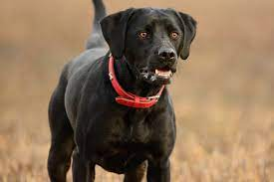
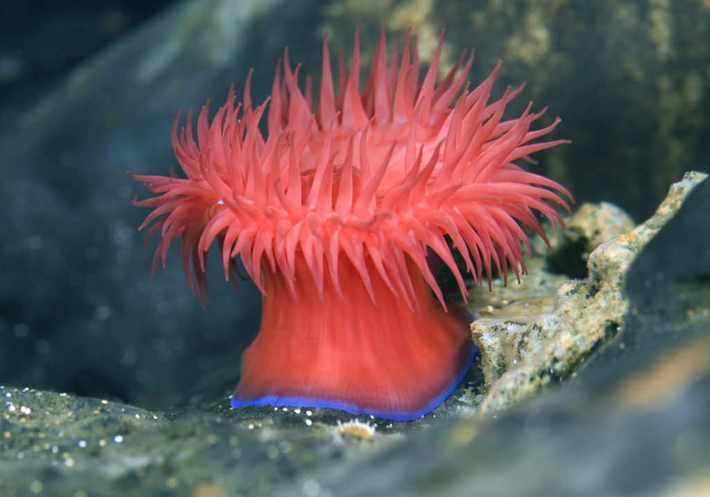
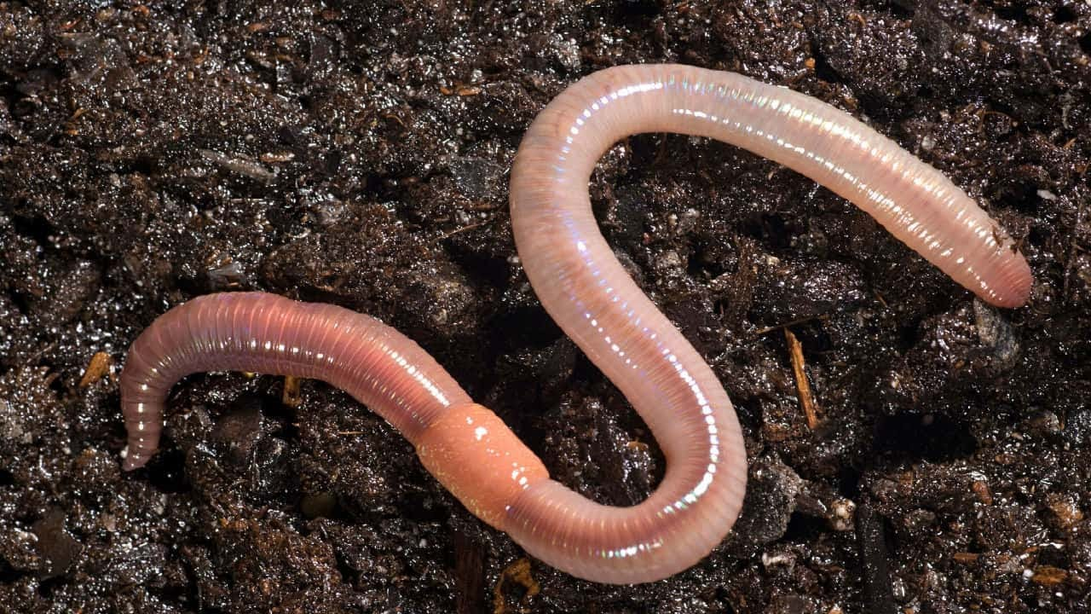
What are the differences between other animals and man?
Using Aquinas Faculties of Human Soul worksheet from yesterday…
Do animals have all the same powers as humans?
If not, which are lacking? Do all animals have all the other powers?
Reactions to Humans, Animals, Memory and Understanding assignment

Slide 18
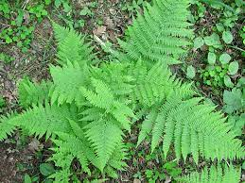
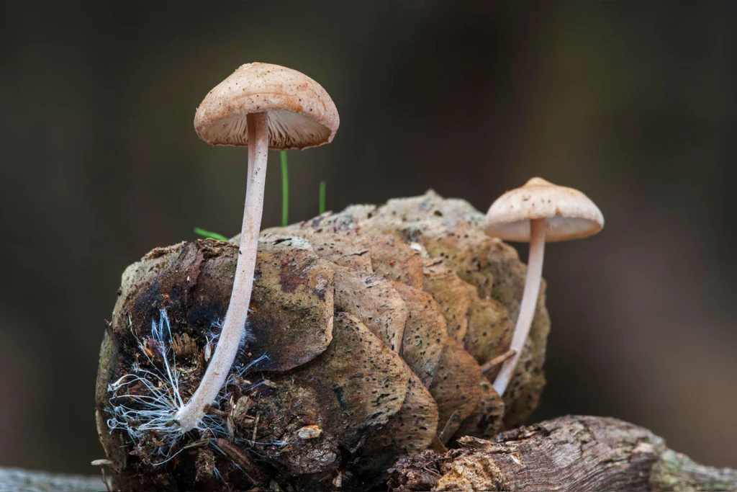
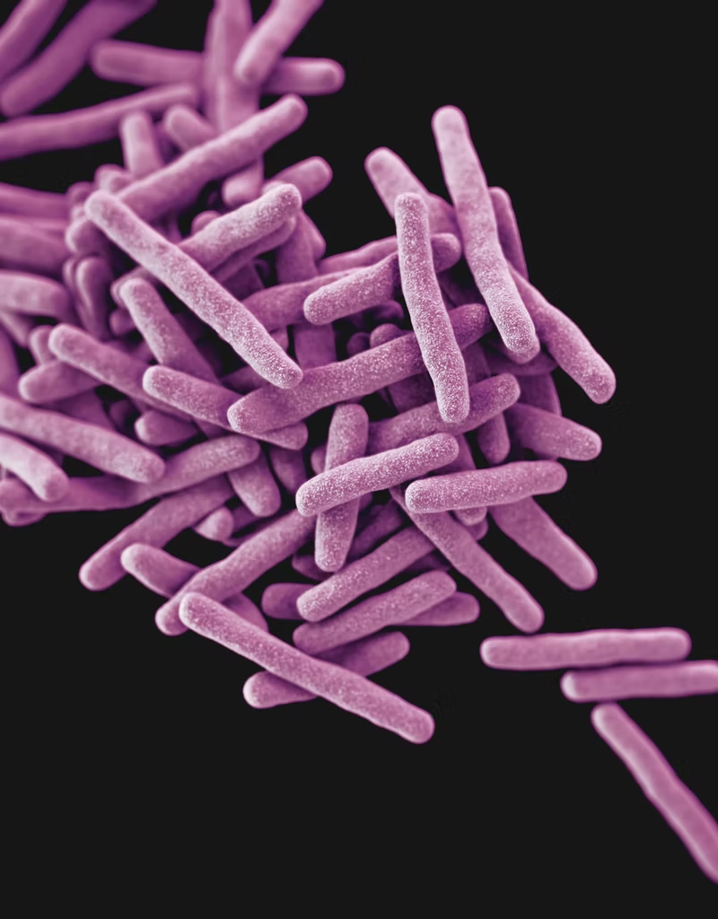
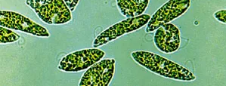
What powers/faculties to plants have?
What about the other kinds of natural living things we identified yesterday?

Slide 19
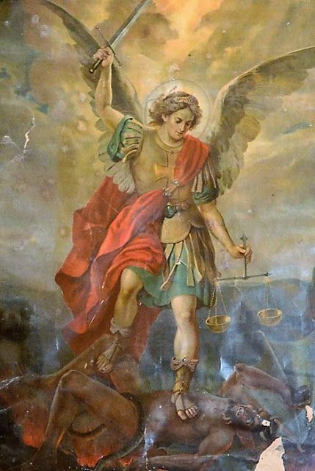
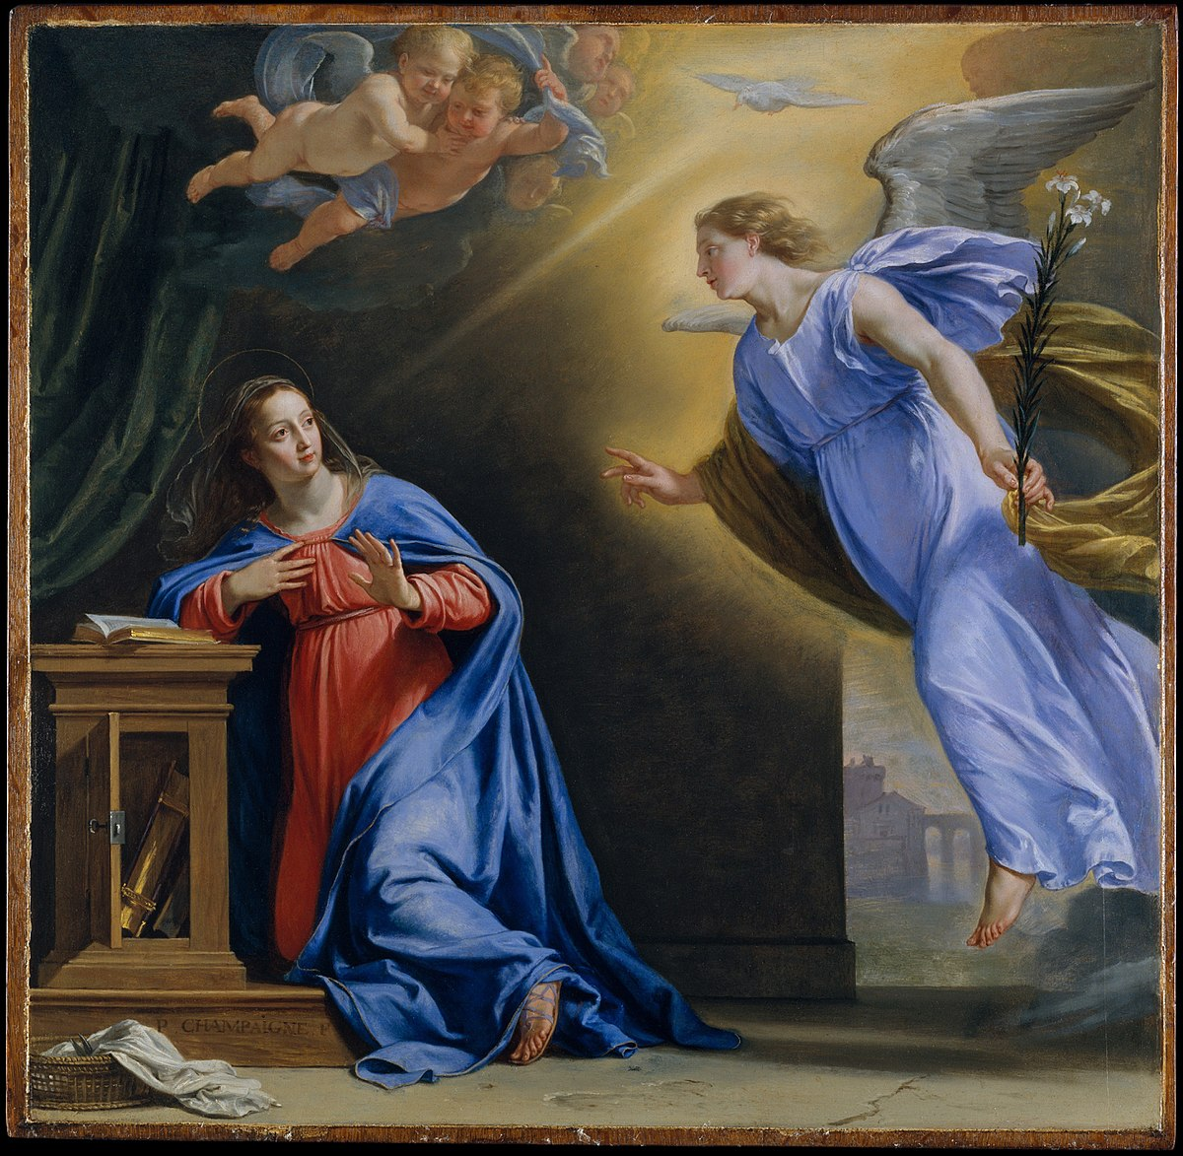
What powers/faculties do Angels have?
Are angels alive? Will we study angels in Biology?

Slide 20
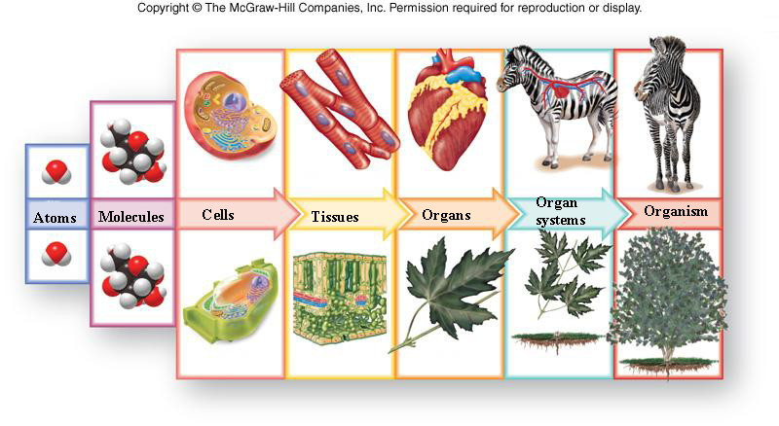
Next…Levels of Organization in Biology A&R p16-19
Image Source: http://legacy.hopkinsville.kctcs.edu/instructors/Jason-Arnold/VLI/m1science/m1science2.html

Slide 21
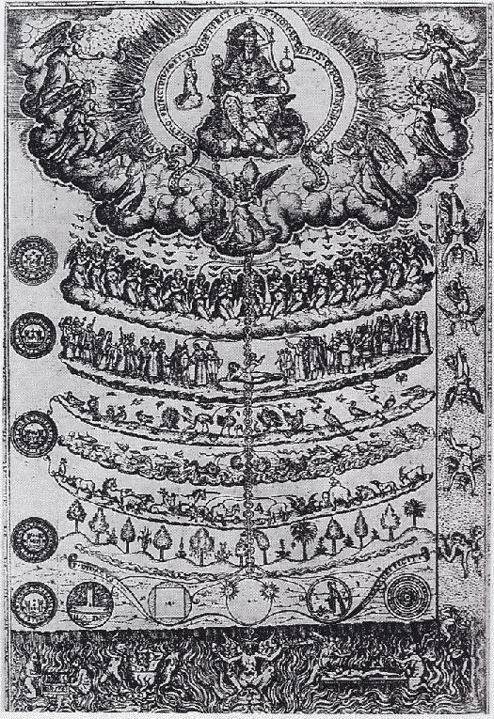
Great Chain of Being
hierarchy of living beings
souls have more powers going up chain
first developed by Aristotle and Plato
further developed by the Scholastics → include angels and God
scientific materialism → more predominant → idea of soul fell out of favor
Catholic Theology → all living things have a soul → the soul is the formal cause of the body

